Slide 1

Engine rod
Politecnico di Torino – MSc Automotive Engineering
Numerical Modelling and Simulation – Part A – prof. Alessandro Scattina
Accademic year 2024/2025
Tommaso Massone

Slide 2
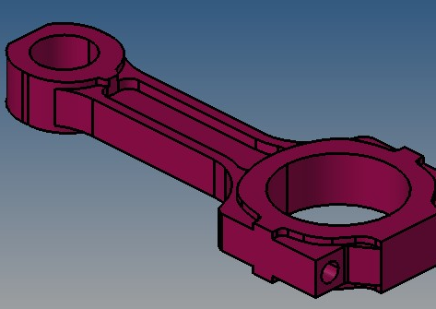
Creation of model
Discretization and creation of the mesh using tetrahedral elements
Definition of proprieties and material characteristics, and next application to the mesh
Using temporary nodes create the master nodes on each force and constraints points of application, keep in mind how the load is applied and on what side it is turned
Apply force and constraints on the rigids created before (all temp nodes have to be eliminated, loads have to be connected to mesh’s node)

Slide 3
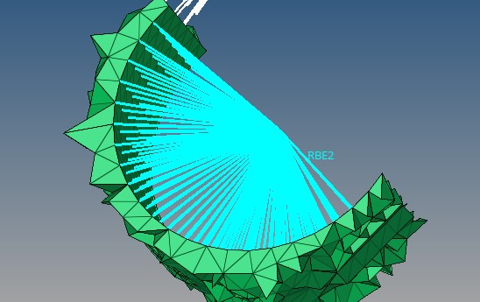
Master node, where the conditions will be applied, to be rigidly transmitted to all slave nodes
Master node : if the boundary condition, constraints or load, can not be applied directly to one node, because of different configurations, a master nodes can be created to connect all the interested nodes, called slaves. As it is shown later, it’s important to choose correctly the slaves nodes

Slide 4
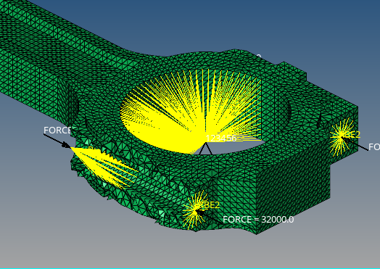
Rigid nodes in the screw hole:
In the lower part of the engine rod it is possible to consider the load applied by the head of the screw, the salve nodes are extended to the second superficial circle around the hole
For the upper part, as it should be considered according to the geometry, consider the hole threaded and select as slave nodes the first 5 threads (where the 90% of the load is carried), starting from the surface of interface between the 2 rod parts

Slide 5
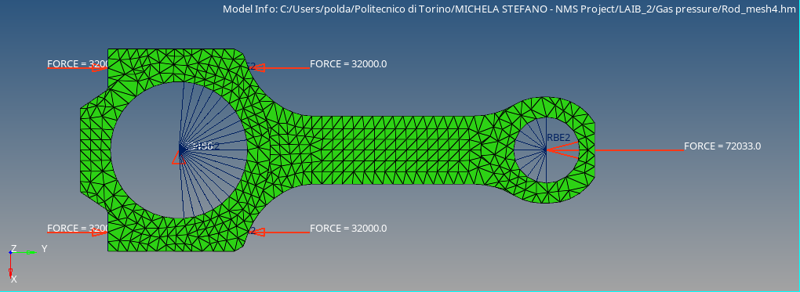
2 critical conditions for the stress state
Forces due to pressure of the gas: the force is applied in the middle of the top hole, the one connected to the piston. The master node must be created considering that the only solicited part by this force is the half circle directed to the bottom, the one where, practically, the force is applied.
The total force considered here is the vectorial sum between the force due to gas pressure and inertia @1900 rpm, where the max pressure is produced

Slide 6
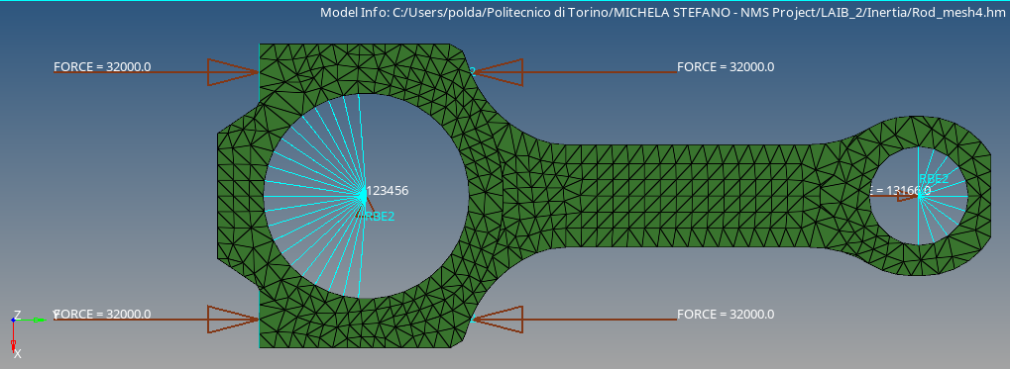
Forces due to inertia : current situation is the period where the piston is reaching the top dead center and so is decelerated (inertia act on the direction of the previous movement); because of the vector is in opposite direction, also the region of the circle where the force is applied is the opposite, half circle directed to the top

Slide 7
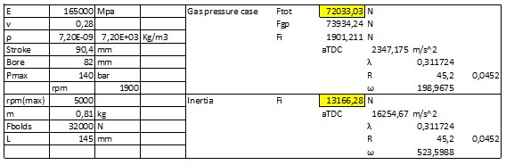







Data Analysis
$$F_{tot}=F_{gp}−F_{i@1900}$$
$$F_{pg}=\frac{πD^{2}}{4}∙p_{max}$$
$$F_{i}=m∗a_{TDC}$$
$$a_{TDC}=\left(1+λ\right)∗R∗ω^{2}$$
$$ω=\frac{2∗π∗n}{60}$$
$$R=\frac{Stroke}{2}$$
$$λ=\frac{R}{L}$$

Slide 8
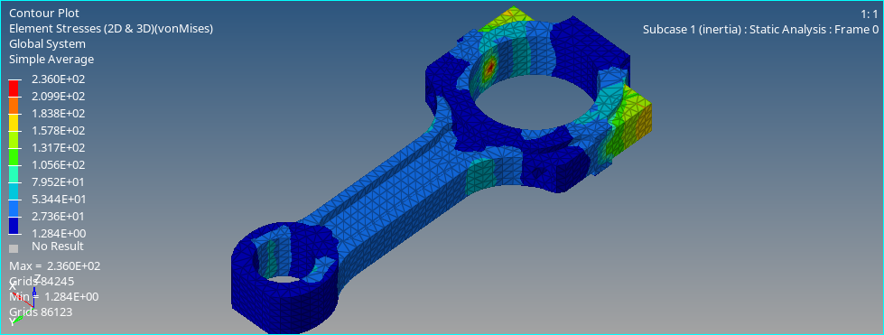
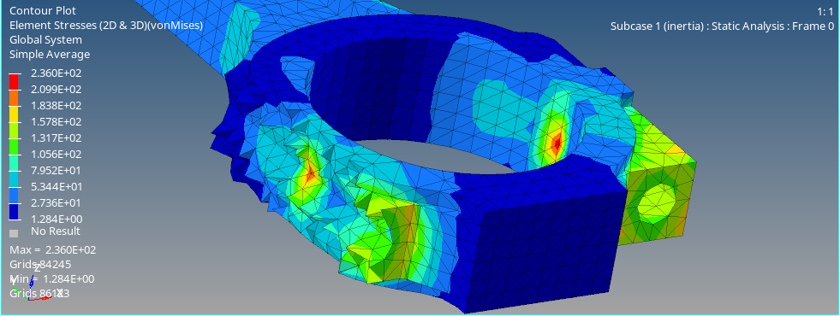
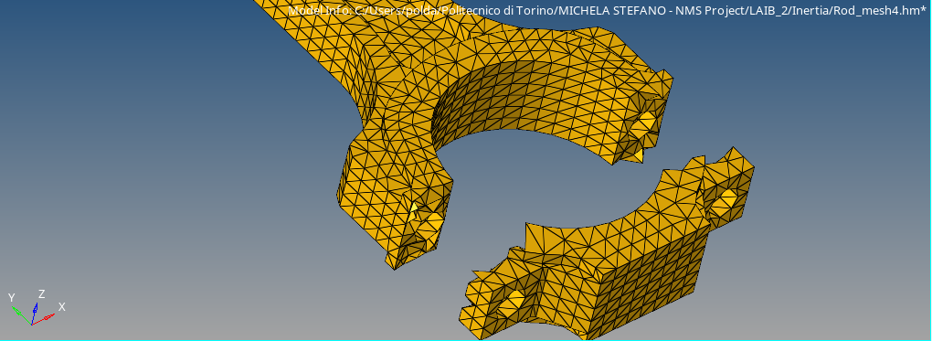
Stress state
Inertia force
Mesh element size: 4mm
The asymmetry in the stress distribution could be determined by a different mesh configuration

Slide 9
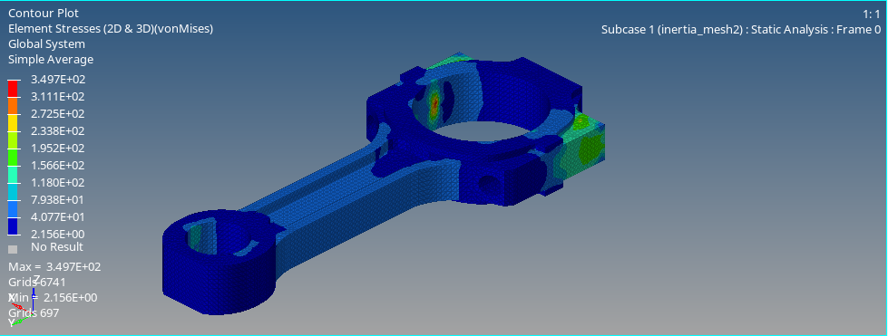
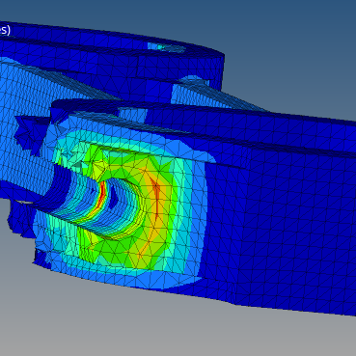
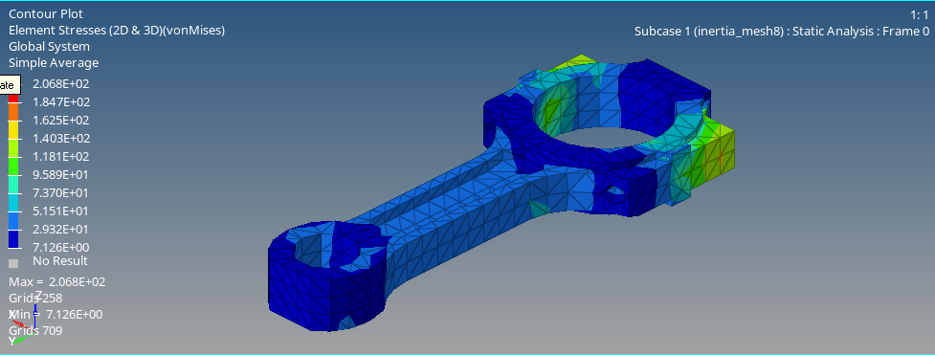
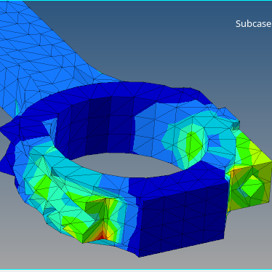
Mesh element size: 2mm
Mesh element size: 8mm

Slide 10
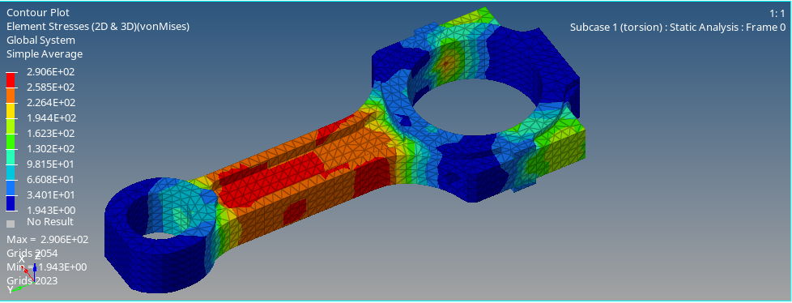
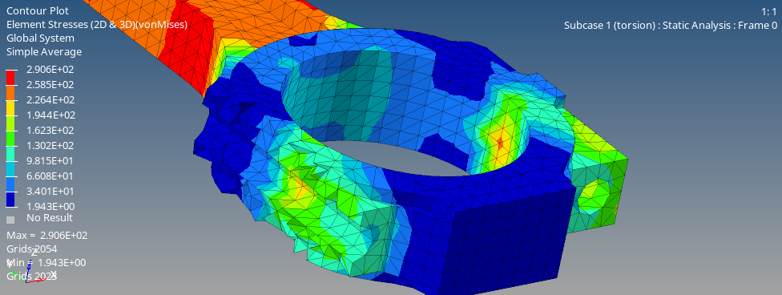
Gas pressure force
Mesh element size: 4mm

Slide 11
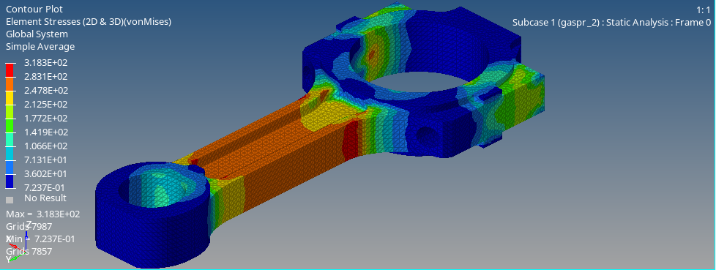
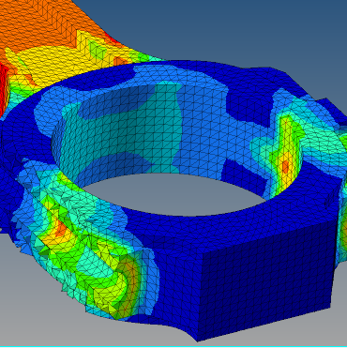
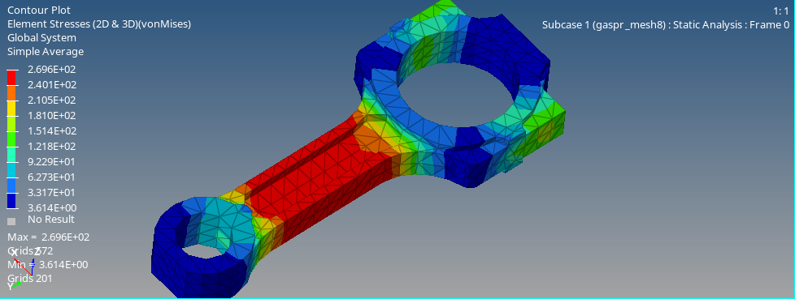
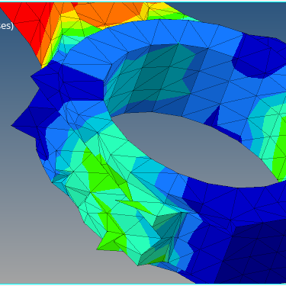
Mesh element size: 2mm
Mesh element size: 8mm

Slide 12
Critical analysis
Increasing the number of nodes in the mesh it is possible to have a more accurate identification of the critical point, because the software generate a better diagram of the stress distribution. Furthermore, the problem of the asymmetry highlighted in the previous slide is reduced by the increasing accuracy of the mesh.
The most critical situation is the one where the rod is subjected to gas pressure force and this affects, particularly the link part between the 2 rings at the extremities; while in the case of inertia the most critical part, is located in the connection between the 2 part of the engine rod made by the screws.

